Slide 1

A+

Slide 2
INTRODUCTION TO COMPUTERS

Slide 3
COMPUTER
An Electronic Device that performs arithmetic and logical operations.
Machine that performs tasks , such as calculations, under the control of a set of instructions called a program.

Slide 4
TYPES OF COMPUTERS
Micro Computers (Desktop)‏
Mini Computers
Mainframe Computers
Super Computers

Slide 5


MICRO-COMPUTERS
These computers are the cheapest and the most widely used computers (also known as personal computers).
E.g.:- Laptops, PDA’s (personal digital assistant) etc.

Slide 6
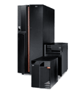
MINI COMPUTER
A mini-computer is larger than a PC but generally smaller than a mainframe. A common operating system is UNIX though manufacturers may have their own proprietary operating systems as well. Ex. Mini-computers are well suited for use in commercial, business, engineering and scientific applications.

Slide 7
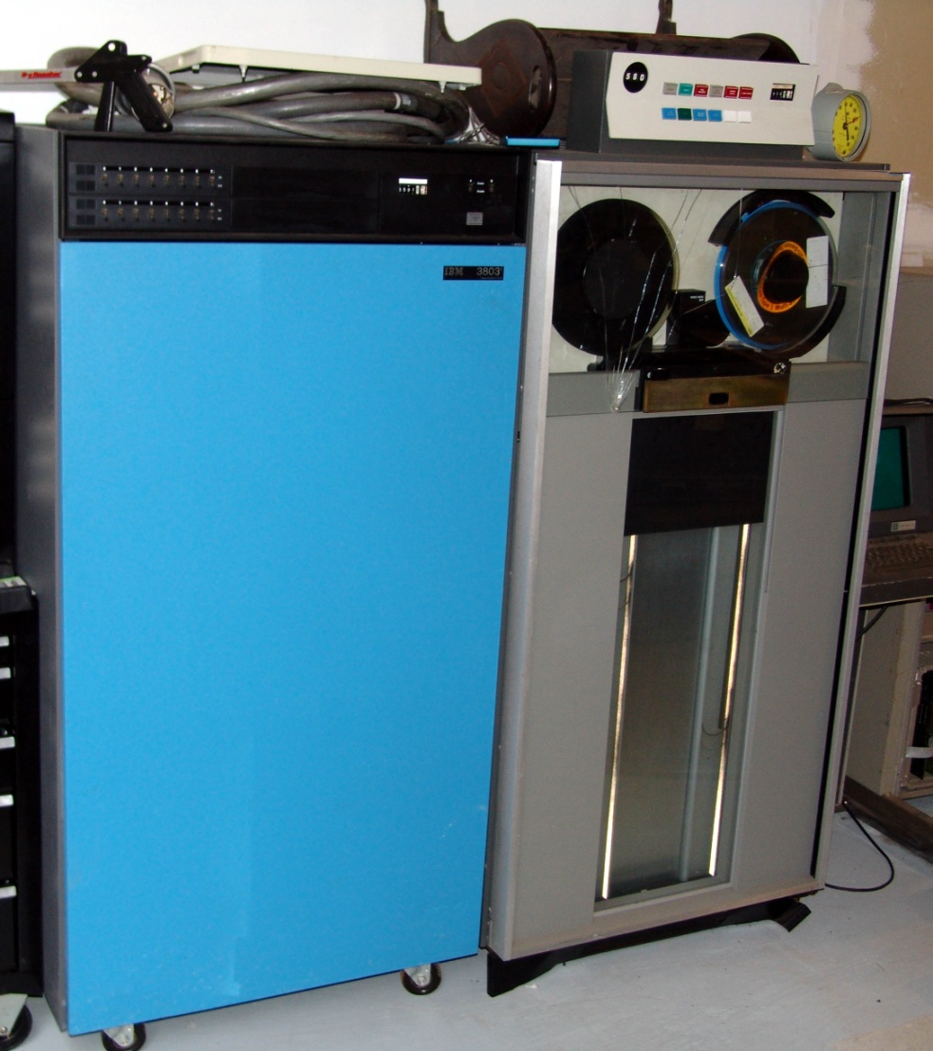
MAIN FRAME
A mainframe may be shared by large number of users, often numbering in the hundreds. Processing, storage and printing are shared services provided in the mainframe
Ex. Banks, insurance companies and large national or international companies use mainframe computers.

Slide 8
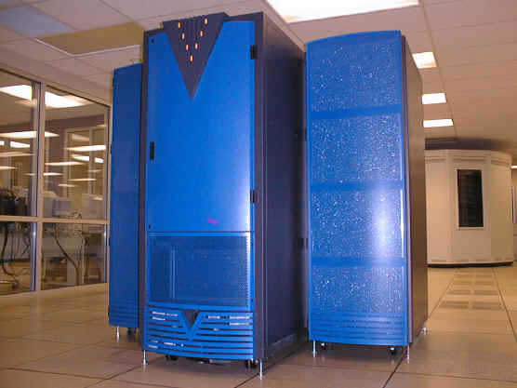
SUPER COMPUTER
They are very large computers with very large computing power and huge RAM. One supercomputer contains 5800 processors and more than a trillion bytes of RAM.
Ex. Supercomputers are mainly used in the science and engineering projects.

Slide 9
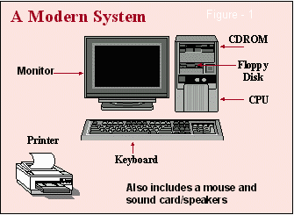
What is ???
Hardware
Software
1. Application s/w
2. System s/w
Firmware

Slide 10
COMPUTER
HARDWARE
SOFTWARE
Processor
Motherboard
RAM
Hard Disk
SMPS
Monitor
Keyboard
Mouse
Printers etc.
System software
e.g.:-Operating system
Device drivers etc.
Application software
E.g.:-Ms-office
CorelDraw etc.

Slide 11
HARDWARE : Hardware describes all the physical components of computer i.e. Keyboard, Mouse, Monitor, Hard disk etc.
SOFTWARE : Software is the set of instructions or the collection of programs. There are 2 types of software.
1. System Software – Windows, Linux etc.
2. Application Software – Ms-Office, Winamp etc.
FIRMWARE : Firmware are the programs that are permanently written and stored in computer memory.

Slide 12
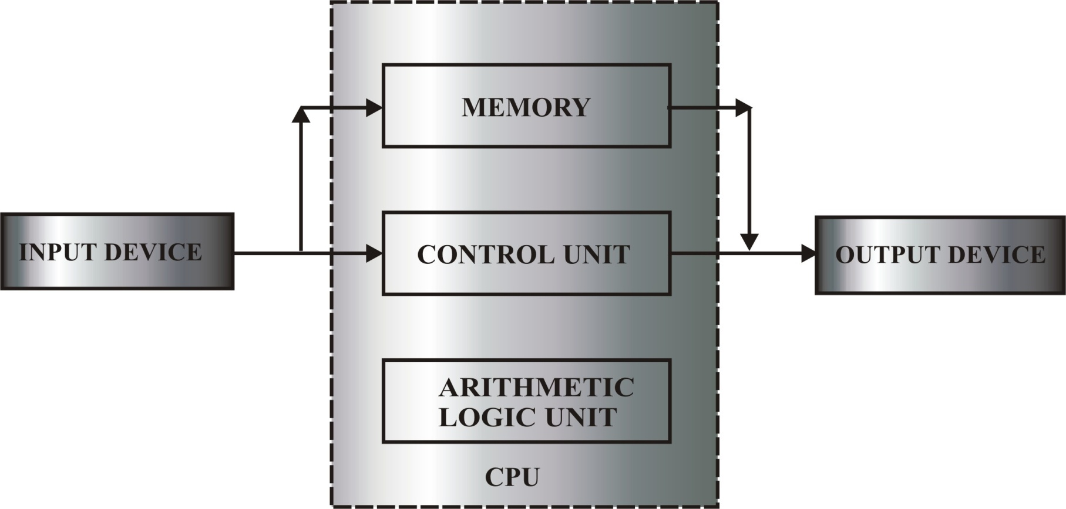
BLOCK DIAGRAM OF THE COMPUTER
Keyboard, Mouse
Monitor, Printer

Slide 13
MEMORY MEASUREMENTS
8 bits = 1Byte = 1 character
1024 Bytes = 1KB (kilobyte)‏
1024 KB = 1MB (megabyte)‏
1024 MB = 1 GB (gigabyte)‏
1024 GB = 1 TB (terabyte)‏

Slide 14
MEMORY
Primary memory
secondary memory
MAGNETIC TAPE
OPTICAL DISK
HARD DISK
FLOPPY DISK
RAM
ROM
It can be defined as the place where the data is stored

Slide 15
RAM (Random Access Memory)
RAM is call Random Access because one can access
any memory cell which is the basic unit of data storage.
It’s a volatile memory
Ram is used for temporary storage of data.

Slide 16
Types of RAM
SRAM
DRAM (dynamic)
EDO RAM (extended data output)
VRAM (video)
RDRAM (rambus dynamic)
SDRAM (synchronous dynamic)
DDRRAM (double data rate)

Slide 17
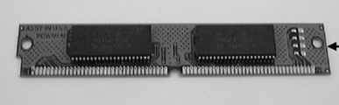
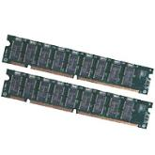
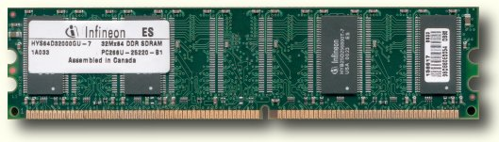
Types of DRAM
EDO RAM (Extended Data Out)
Pins- 32-72, 2MB-8MB
SDRAM (Synchronous Dynamic RAM)
Pins- 168, 16MB-256MB
DDR (Double Data Rate)
Pins-184, 128MB-2GB

Slide 18
ROM (Read Only Memory) :
→ Non-volatile memory.
→ Contains PC’s startup instructions.
→ It is a chip present on the Motherboard.
The following are the set of programs contained in ROM.
→POST (Power On Self Test): - The POST tests computer’s processor, memory, chipset, video adapter, disk drives and other hardware.
→BIOS (Basic input/output system): - This refers to the collection of device drivers used to act as a basic interface between the operating system and the hardware when the system is booted and running.

Slide 19
Types of ROM
PROM (Programmable ROM)
EPROM (Erasable PROM)
EEPROM (Electrically Erasable)

Slide 20
DRIVE ROM
CD-R
CD RW
DVD-R
DVD-RW
COMBO
BLUE-RAY DRIVE

Slide 21
CD-ROM DRIVE
The optical disc drive is now an Universal device on computers.
One CD or DVD is equivalent to hundreds of floppy disks.
It is used to store Data, Songs, Videos etc

Slide 22

CD-ROM DRIVE

Slide 23
STORAGE DEVICES
Hard Disk
Floppy Disk
CD-ROM

Slide 24
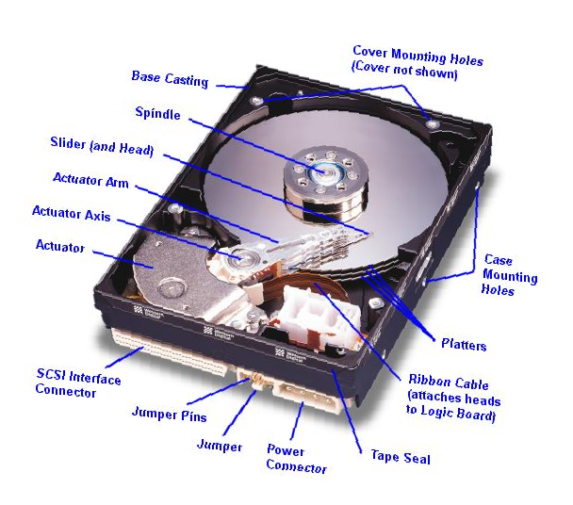
HARD DISK

Slide 25
HARD DISK (H.D.D)
It is a secondary storage device.
It Stores the data permanently which the CPU has been processed
It has the large storage capacity
It is non-volatile
It is used to store songs, movies, and large Data files

Slide 26
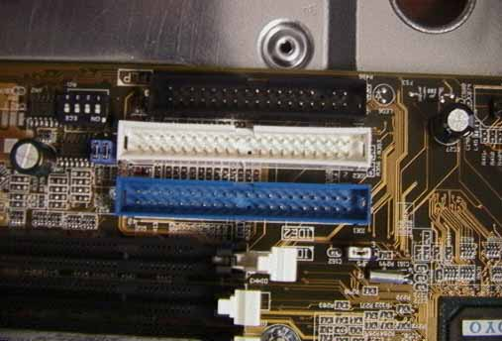

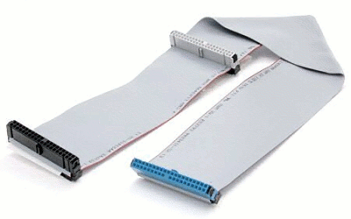
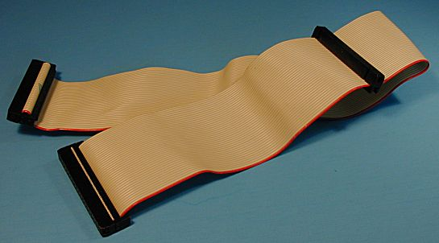
1. IDE (Integrated Drive Electronics) Connectors
Power Connector for Hard disk
IDE connectors
40 Pin IDE
40 Pin Ultra IDE

Slide 27
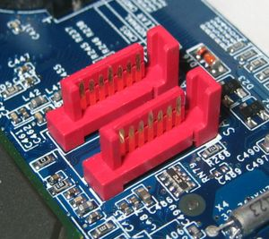
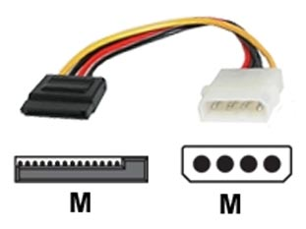
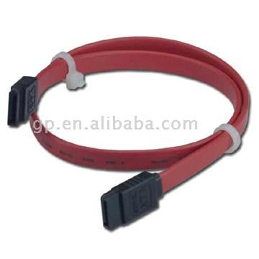
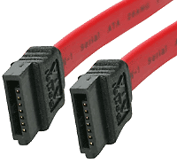
2. SATA (Serial Advanced Technology Attachment)‏
SATA Ports
(7pin 7 wires)‏
Power Connector For SATA from Molex
SATA Cables

Slide 28
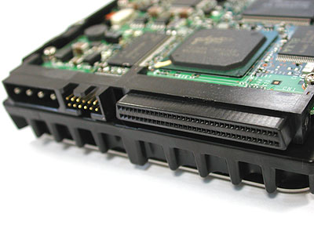
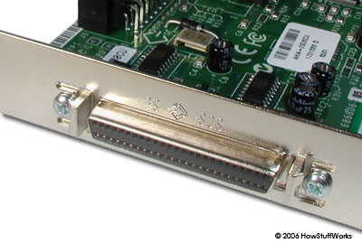

3. SCSI (Small Computer System Interface
SCSI Hard Disk
(68 pins)‏
68 pin (P) connector on M/B.
P Cable

Slide 29
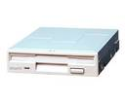
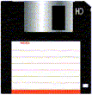
FLOPPY DISK DRIVE

Slide 30
FLOPPY DISK
It is the secondary storage device
It has a limited storage capacity
It is used to store Documents and Spreadsheets files

Slide 31
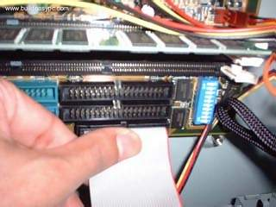
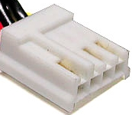
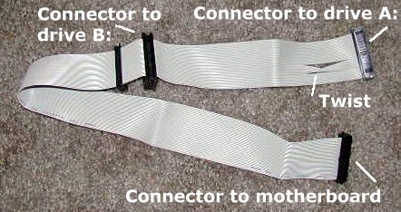
Floppy Drive Connector
Mini Molex
Power Connector for Floppy Drive
Floppy Drive Cable

Slide 32
CPU
The CPU (central processing unit, may be called the Microprocessor) is essentially, the brain of the computer. It contains circuits that
(1) perform arithmetic and logic Calculations (ALU, Arithmetic Logic Unit)
(2) control the devices attached to the processor (Control Unit)
(3) has very high-speed memory (cache memory).

Slide 33
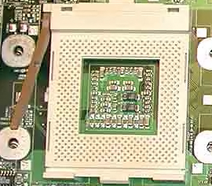

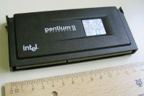
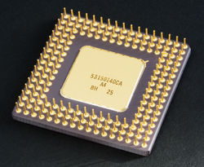
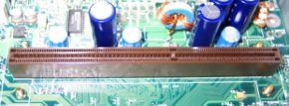
PROCESSORS
Socket
Pin less Processor
Slot Processor
Processor
Processor Slot

Slide 35
5th Generations of Processor
Processor
Bits
Speed
Pentium
32
60 – 233 MHz
Pentium Pro
32
150 – 200 MHz
Pentium II, Celeron , Xeon
32
233 – 450 MHz
Pentium III, Celeron , Xeon
32
450 MHz – GHz
Pentium IV, a , Xeon
32
1.3 GHz – 3.8 GHz
Itanium
64
800 MHz – 3.0 GHz

Slide 36
Manufacturers of Processors
Intel
AMD
Cyrix
Motorola
MAC

Slide 37
Sockets
ONLY FOR INTEL PROCESSOR
PGA 370 PIII
PGA 478 PIV
LGA 775 for Pin less PIV, Dual Core, Core 2 Duo and Quad core Processors
ONLY FOR AMD
PGA 756
PGA 939
PGA 940 (AM2) for X2 Processor (Dual Core)

Slide 38
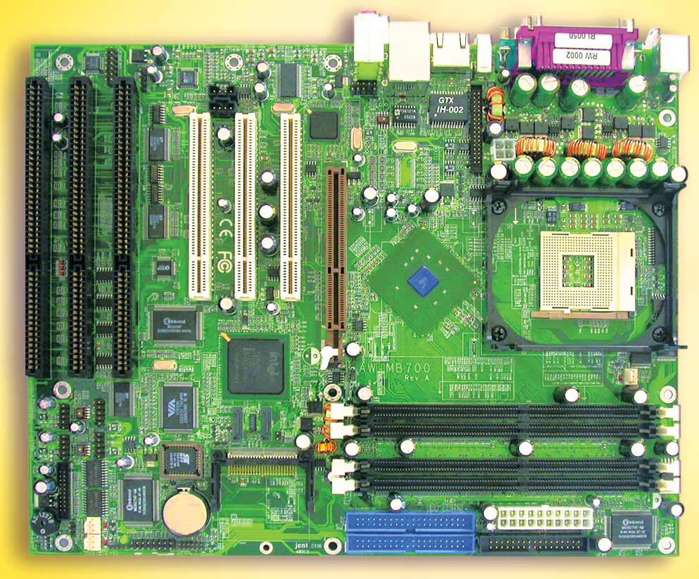
MOTHERBOARDS

Slide 39
MOTHERBOARD
It is circuit board also known as the system Board.
It is known as a planer board & main board.
All components are attached on the Board.
The board contains : - Central Processing Unit (CPU), underlying circuitry, expansion slots, random access memory (RAM) slots, and a variety of other chips.

Slide 40
Components on Mother Board
Chipset
South Bridge & North Bridge
Expansion Slots
Peripheral Ports
C.P.U Slot
Memory Slot
Key Board & Mouse Slots
Disk Controller Slots
Power connector slot
BIOS & CMOS Battery
Jumpers & DIP switch
Firmware

Slide 41
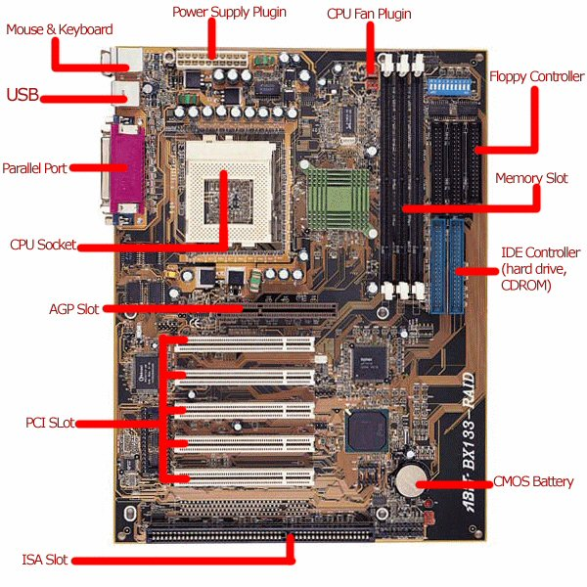

Slide 42
Name of Motherboard Manufacturer
Intel
Asus
Gigabyte
HIS
Mercury

Slide 43
Model Number of Motherboard
810 and 815 for P III
845 and 865 for PIV
915, 945 and 975 for PIV, Dual Core and Core2Duo.

Slide 44
Chipset
Chipset is a set of chips
Chipset made of two types of Chip which perform their different functions.
1) North Bridge
2) South Bridge

Slide 45
South Bridge & North Bridge
RAM
CPU Socket
Memory Bus
IDE
FSB (Front Side Bus)
North
Bridge
IDE Bus
AGP Bus
AGP Slot
South
Bridge
PCI
Slots
FDC Bus
PCI Bus
FDC

Slide 46
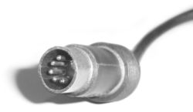
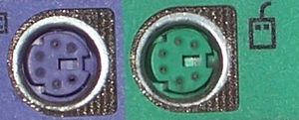
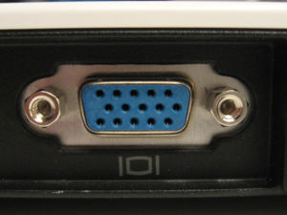
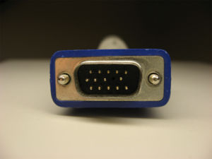
DIN5: ( Deutsche Industry Norm )‏
5 Pin Normal Keyboard Connector
PS/2: (Personal System)‏
6 pin Ps2 connectors
Green – Mouse
Purple -- Keyboard
VGA: (Video Graphic Array)‏
15 Pin VGA Connector
Monitor

Slide 47
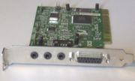
Game and Sound ports
15 Pin connector
Joystick
Line IN
Line Out
MIC
External Audio Sources
Micro phones
Speakers

Slide 48
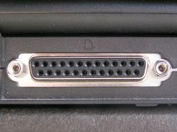
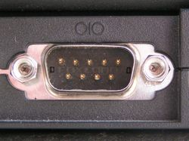
Parallel Port (LPT Port)‏
25 Pin connector
Printers , Scanners
Serial Port (COM Port)‏
9 Pin connector
Serial Mouse , External Modem

Slide 49


USB : (Universal Serial Bus)‏
Keyboard
Mouse
Scanner
Pen Drive
Printers
Many Mores ……
.

Slide 50

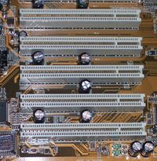
Types Of Slots
ISA : ( Industry Standard Architecture )‏
Width (bits)‏
Speed (MHz)‏
8 / 16
8
PCI : ( Peripheral Component Interconnect )‏
Width (bits)‏
Speed (MHz)‏
32
33 / 66

Slide 51
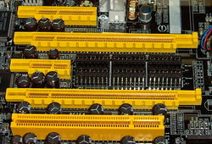
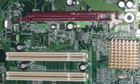
PCI - Express :
Width (bits)‏
Speed (MHz)‏
32
2500
AGP (Accelerated Graphics Port)‏
Width (bits)‏
Speed (MHz)‏
32
533

Slide 52
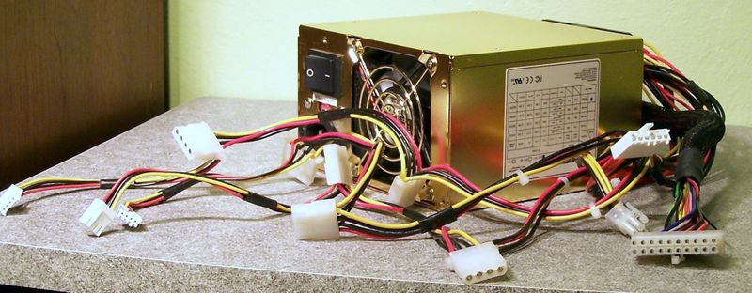
POWER SUPPLY
SMPS : (Switch Mode Power Supply)‏
Electronic devices require electricity to operate. Most internal components are DC (direct-current) but the line voltage is AC (alternating current.) One of the roles of the power supply is, therefore, to convert AC to DC voltage.

Slide 53
TYPES OF SMPS
There are five types of SMPS as under :-
PC/XT :- (Personal computer / Extended Technology)
AT :- (Advance Technology)
ATX :- (Advance Technology Extended)
SFX :- (Small From Factors)
WTX :- (Work Station Technology Extended)

Slide 54
POWER CONNECTORS
AT :- 6+6 PIN Connectors To Supply The Power To The Mother Board. That Connectors Are Known As P8 & P9.
ATX :- 20+4 or 24 +4 PIN Connectors to Supply The Power To The Mother Board.
Molex :- 4PIN Connector to Supply the power to the ATA Hard disk & CD/DVD ROM.
Berg :- small 4 pin connector to Supply the power Floppy disk drive.
SATA :- 15 pin connector to supply the power to sata hard disk & CD/DVD ROM.

Slide 55
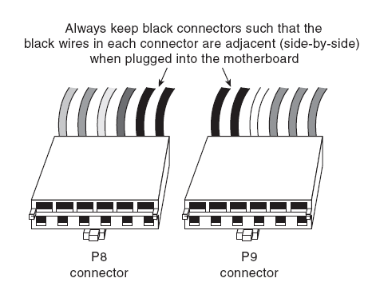
AT (Advanced Technology)‏

Slide 56
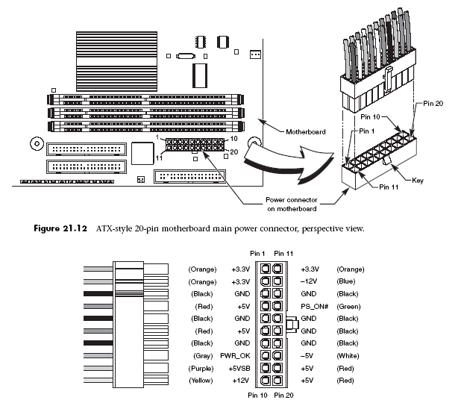
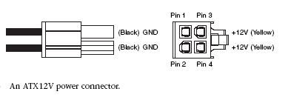
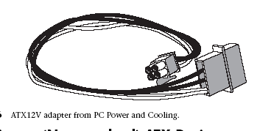
ATX ( Advanced Technology Extended )‏
BTX ( Balanced Technology Extended)‏

Slide 57
BOOT PROCESS
POWER ON
BOOTABLE DEVICE
SMPS
OS LOADING
INTO RAM
MOTHERBOARD
SYSTEM INITIALIZATION
BIOS
CMOS

Slide 58
POWER GOOD SIGNAL
Power supply ensure that the system does not run unless the power supplied is not sufficient to operate the system properly.
The Power Supply is nothing but +5V active high signal that is supplied to the motherboard when output voltage gets stable.

Slide 59
BIOS
BIOS (Basic Input/output system) is a set of instruction or program that acts as a interface between the hardware and the operating system.
ROM BIOS is a chip that contains the start-up programs and drivers used to start the system.

Slide 60
POST
POST (Power On Self Test) is the program stored in the ROM BIOS that runs about system initialization and performs hardware detection task.
When POST detects an error from keyboard, mouse, memory or other devices it produces an error message.

Slide 61
CMOS
CMOS - Complimentary Metal Oxide Semiconductor.
The BIOS needs various parameter (hardware configuration) information to perform its task, these are permanently saved in CMOS RAM.
The CMOS power is supplied by a little battery, so its contents will not be lost after the PC is turned off.

Slide 62
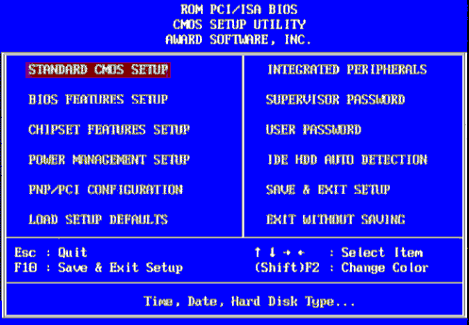

Slide 63
MBR
MBR (Master Boot Record) is located at cylinder 0, head 0, sector 1 of a hard disk.
Boot Sector
Partition Table
Magic Number
446 bytes
64 bytes
2 bytes
MBR = 512 bytes

Slide 64
PC ASSEMBLING
Gather all required devices.
Open the case and remove power supply and drive chassis.
Setup your motherboard
Install the CPU
Install main MEMORY (RAM)‏
Install the power supply.

Slide 65
Connect keyboard, mouse and monitor.
Conduct system check (self test)‏
Install hard disk, floppy drive and cd-rom drive.
Install all data cables.
Connect front panel and speaker.
Connect all power connectors.
Configure the BIOS.
Install the Operating system.

Slide 66
DISPLAY TEST
Required devices :
Motherboard
Processor
RAM
SMPS
Keyboard
Monitor

Slide 67
ASSEMBLING A PC
CABINET
FDD/CDROM
MOTHERBOARD
SMPS
PROCESSOR
DATA CABLES
RAM
POWER CABLES
HARD DISK
POWER ON

